Slide 1
”Medicamentul, intre decizie medicală, interesul pacientului și reglementările in vigoare”

Slide 2
DISCLOSURE
I have the following potential conflicts of interest to report:
Stockholder of a healthcare company NO
Employment in industry NO
Owner of a healthcare company NO
Research Grants: NO
Consulting and Speaker: Servier, Pfizer, Mylan, Terapia, Boehringer Ingelheim, Berlin Chemie Menarini, Novartis, Sanofi, Zentiva, Amgen, Bayer, Vifor Pharma, Alpha - Wasserman
Others (please specifiy) : NONE

Slide 3
Daniel Lighezan, FESC
Politicile medicamentului din perspectiva practicii medicale- protocoale, prescripții și adaptarea tratamentului la nevoile pacientului

Slide 4
Motto:

Slide 5
De la Medicina Bazata pe Dovezi la Ghiduri si Protocoale
Definiţia utilizată extensiv în literatura de specialitate a fost dată de profesorul Sackett în 1996: „…este utilizarea scrupuloasă, clară şi logică a celor mai bune dovezi medicale existente în prezent în luarea deciziei medicale asupra îngrijirii individualizate a pacientului”
Ceea ce trebuie subliniat este faptul că esenţa medicinii bazate pe dovezi este îmbinarea experienţei clinice individuale cu informaţia medicală „bună”, existentă în literatura medicală
Ghidurile sunt asemenea procese de analiză critică a literaturii medicale puse într-o formă uşor aplicabilă în practică, elaborate de comisii de experţi
Protocolul este apanajul unei unităţi medicale, a unui grup de medici uniţi într-o structură organizatorică comună şi au la baza mai ales criterii de organizare. Protocolul presupune o obligativitate, ceea ce îl situează la polul opus ghidurilor. Diferenţa între cele două noţiuni poate fi esenţială în abordarea şi acceptarea lor de către medicii practicieni.

Slide 6
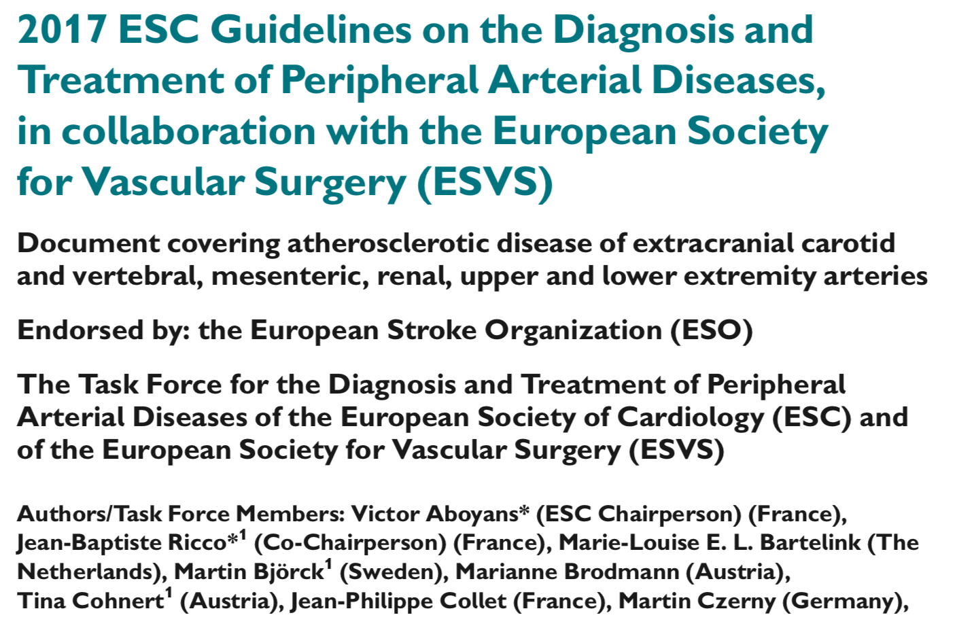
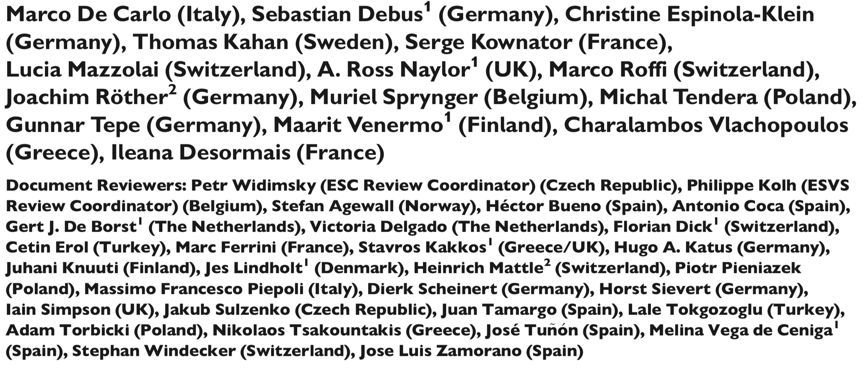

Slide 7
Schimbarea Ghidurilor

Slide 8
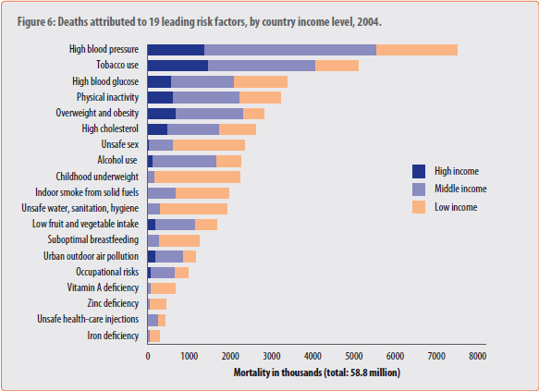
Hipertensiunea arterială și incidența deceselor atribuite factorilor de risc: 30% din toate decesele se datorează direct HTA

Slide 9
Ce a fost pana acum

Slide 10
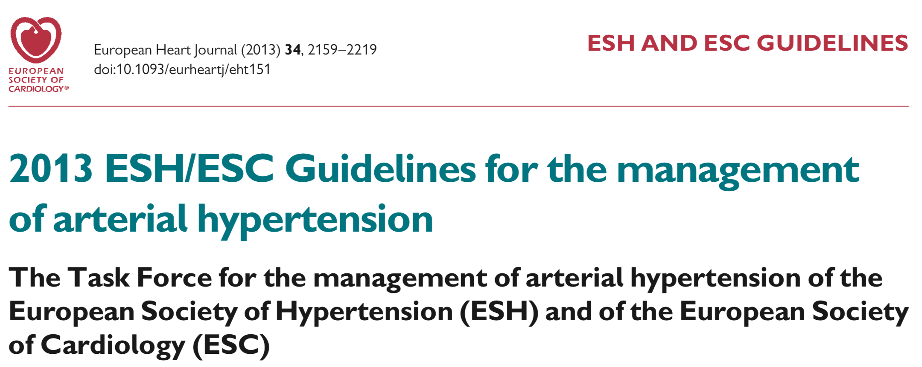
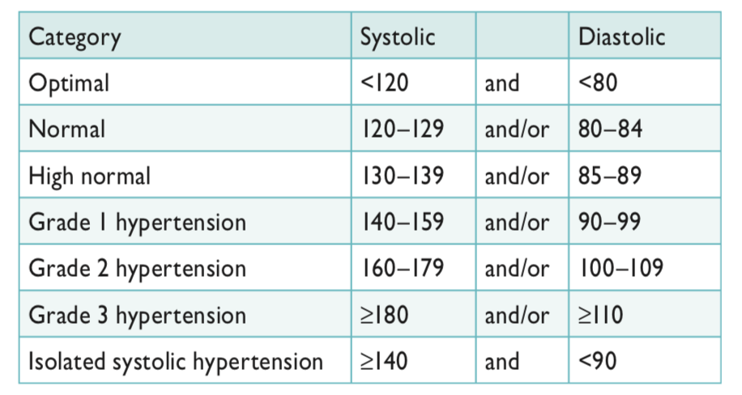

Slide 11
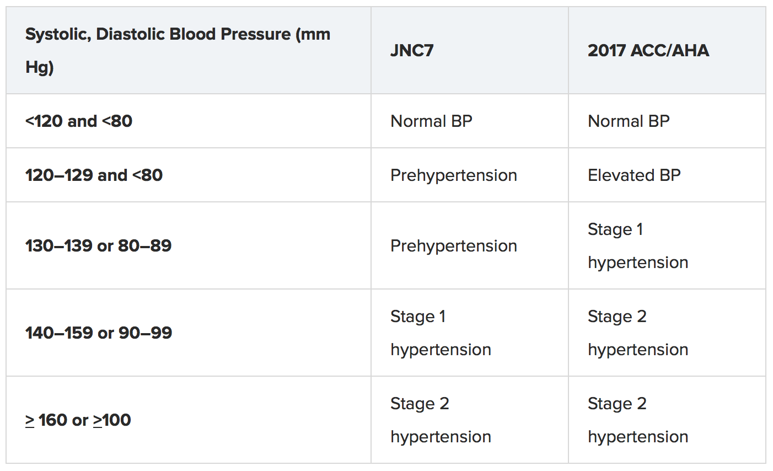

Slide 13
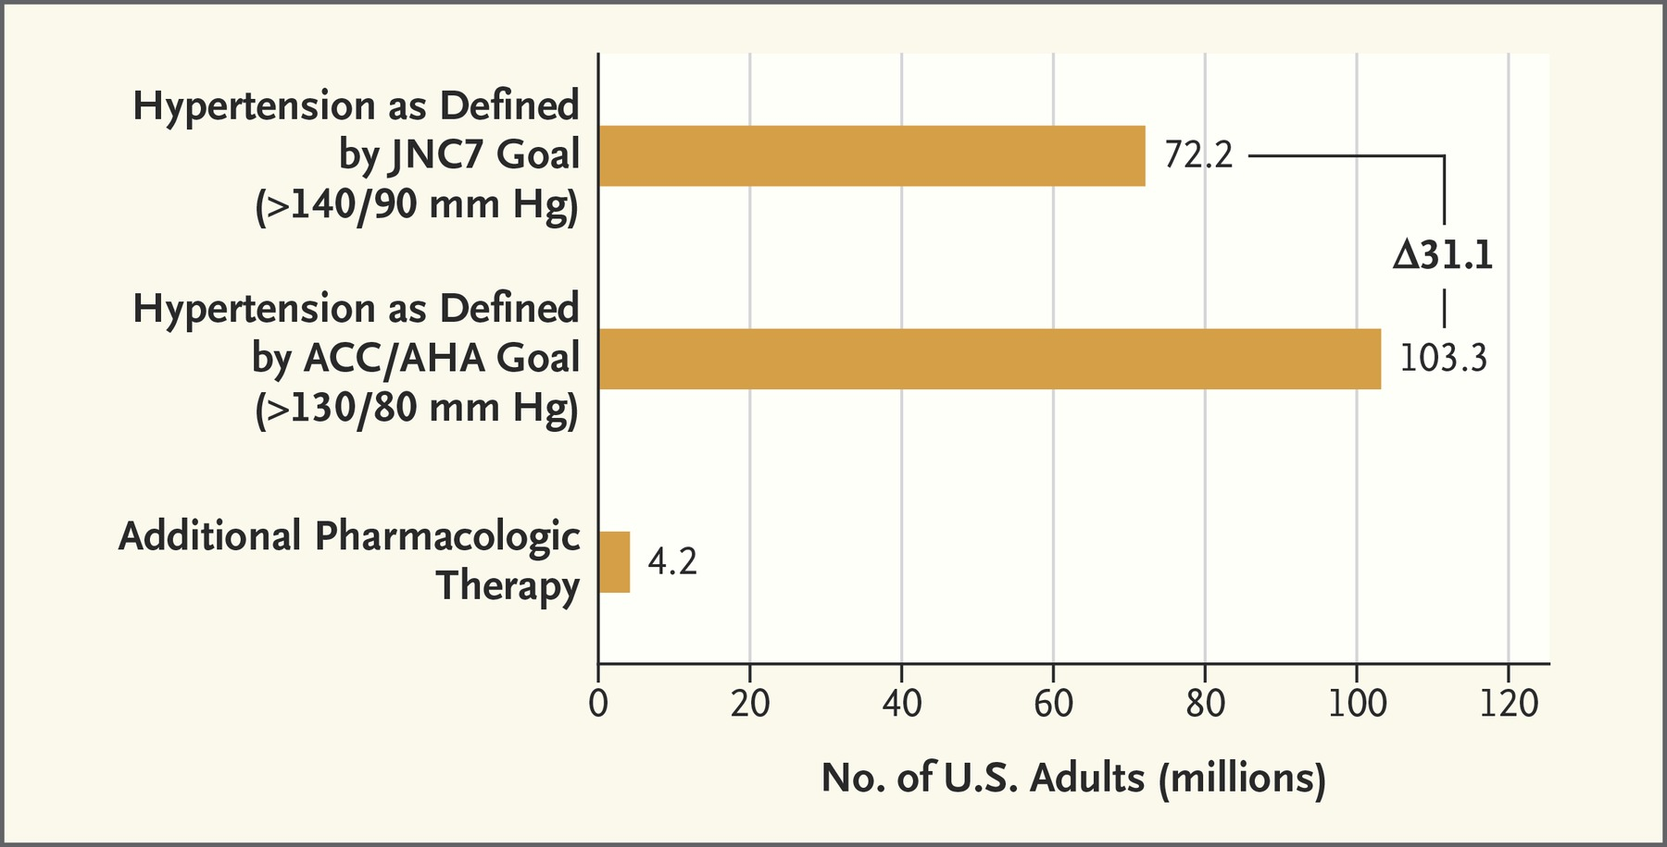
≈42% increase= ≈30 millions more
If the new ACC/AHA target is taken into consideration

Slide 14
Do we really want?
42% increase???
For Romania with 20 million population
16 million adults
SEPHAR III study data show a 49.5% hypertension prevalence
8 millions hypertensive patients
If we take into consideration the new ACC/AHA guidelines we should have an additional: 3.36 millions

Slide 15
11.3 million with hypertension 70% of adult population

Slide 16
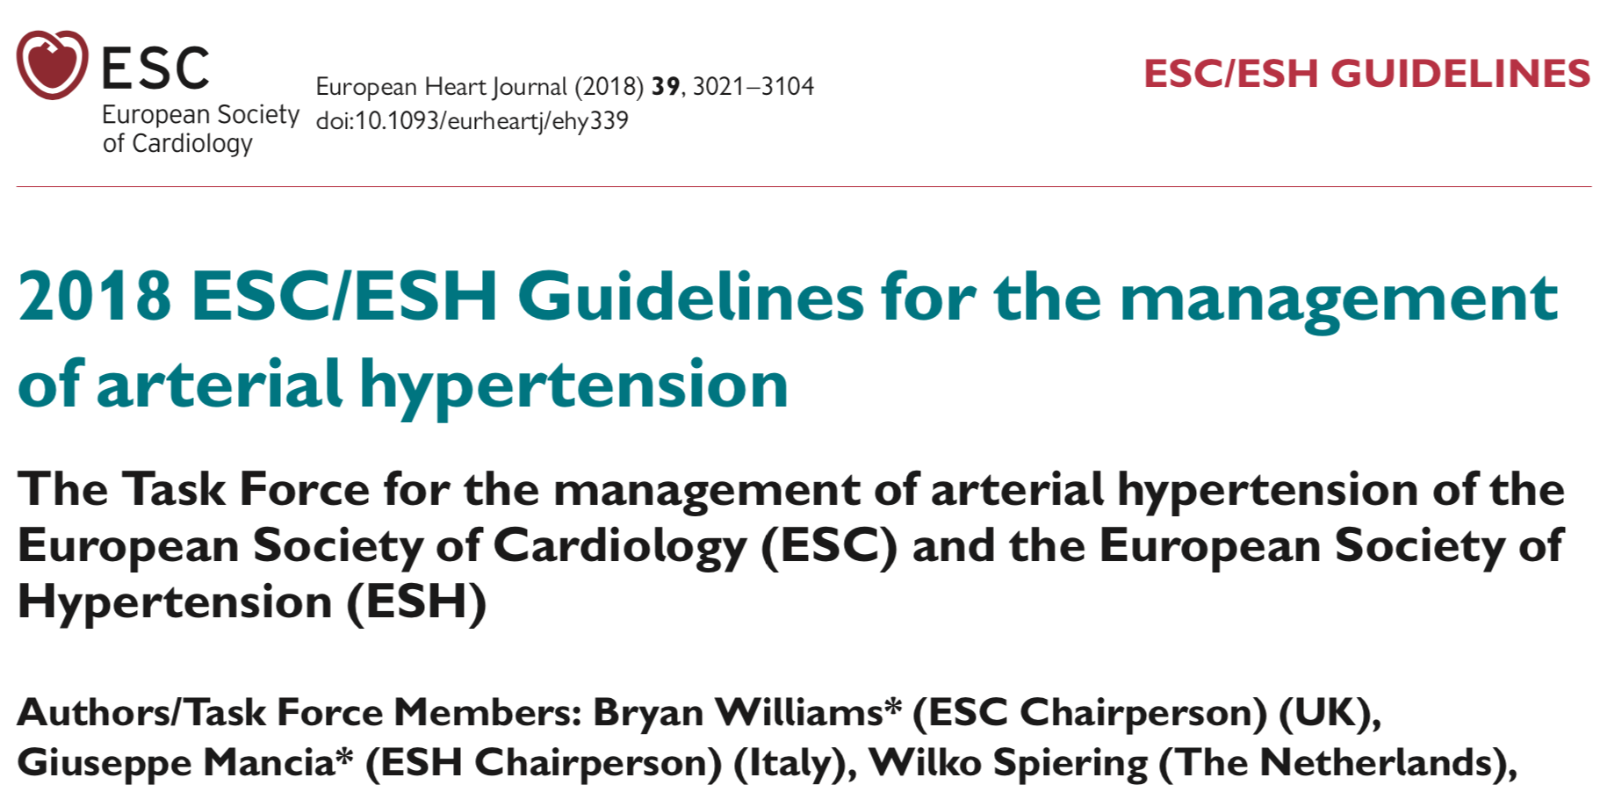

Slide 17
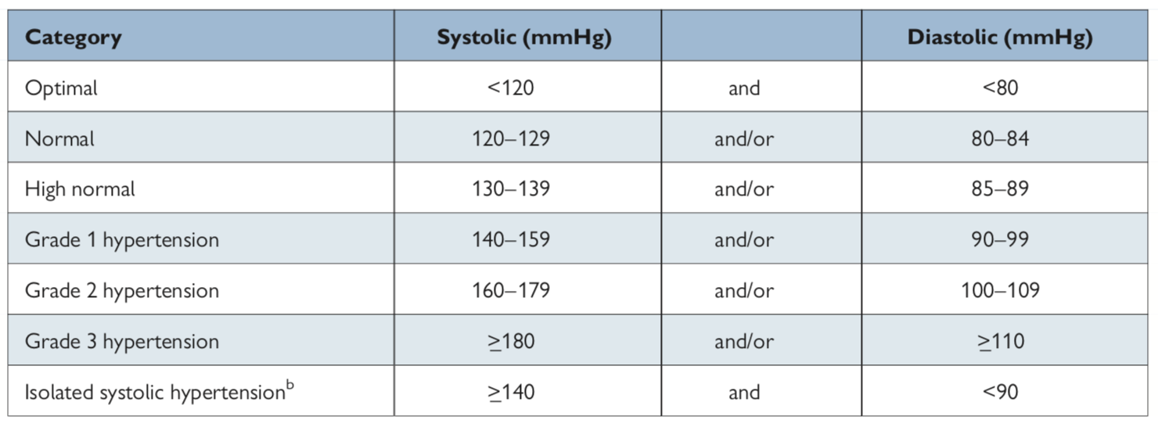
Definitions of hypertension grade

Slide 18
La ce valoare controlam

Slide 19
2017 AHA/ACC Hypertension Guidelines

Slide 20
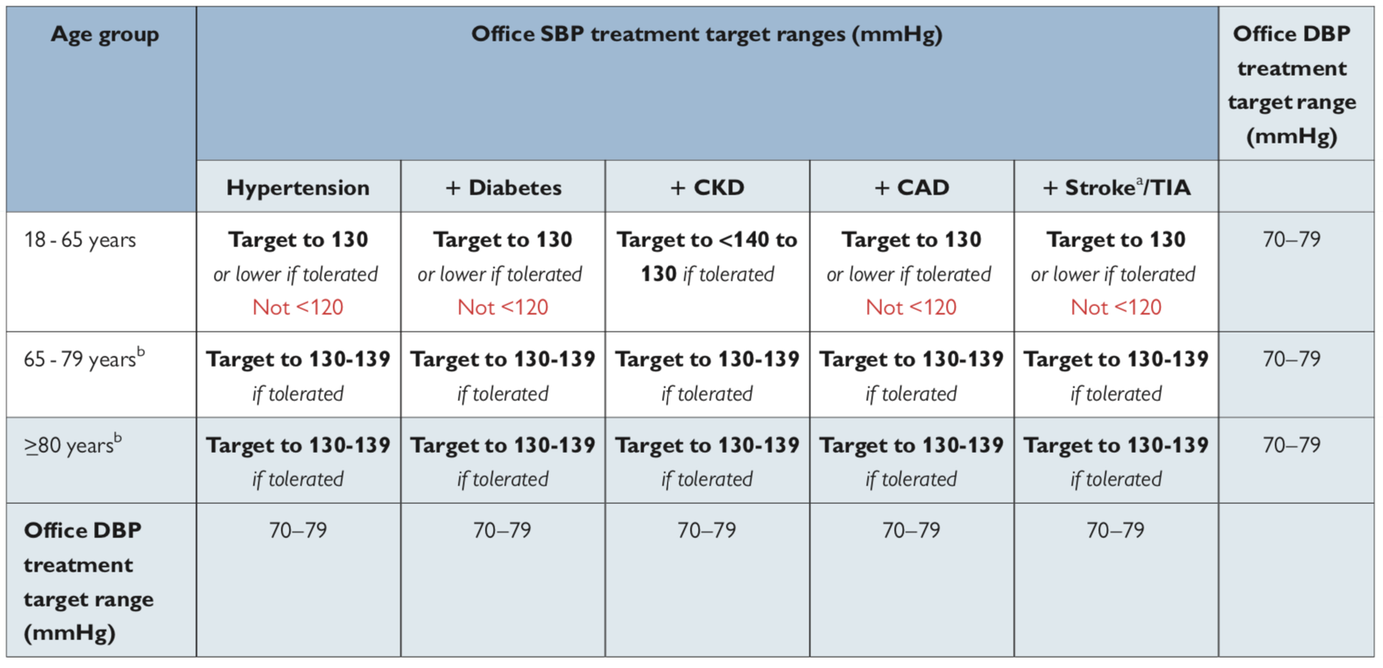

Slide 21
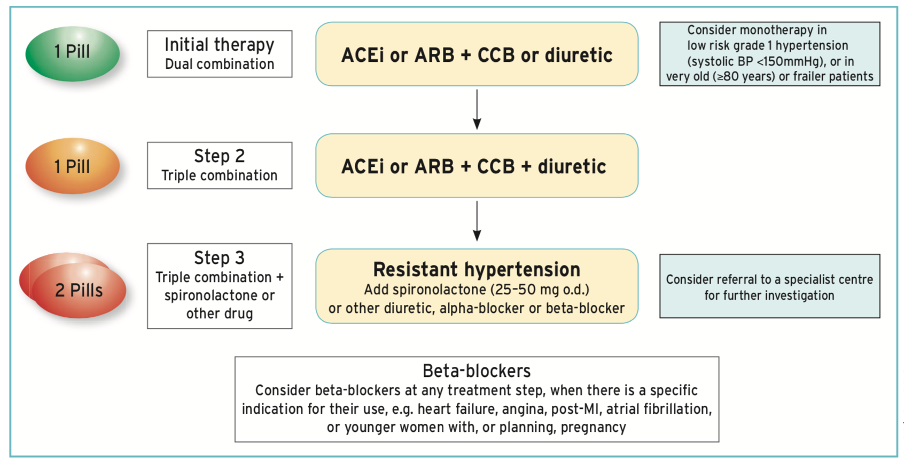
Therapy in uncomplicated HT

Slide 22
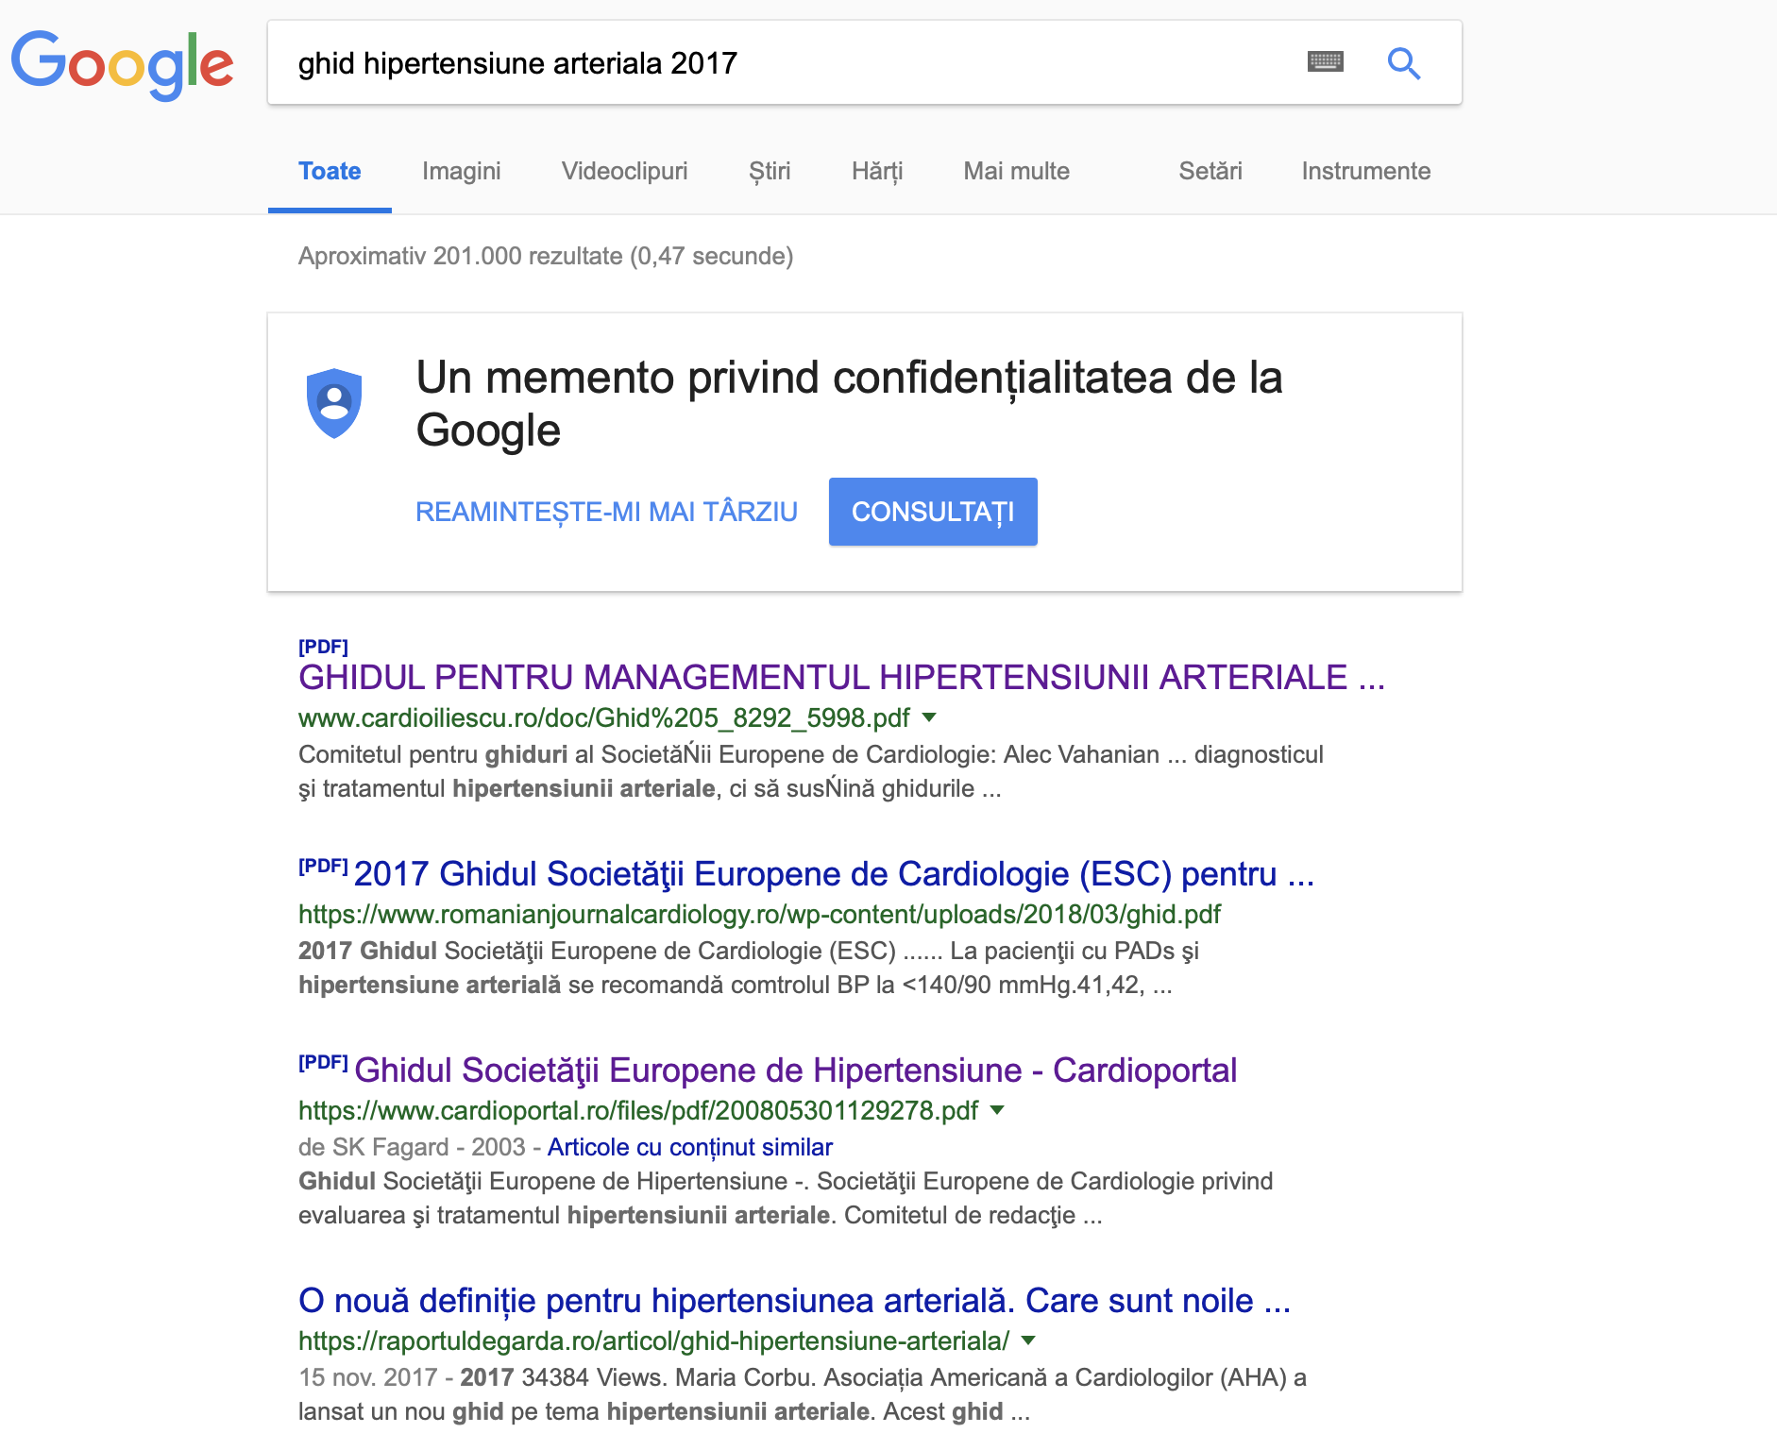
Unde ne aflam noi? 24.10.2018

Slide 23
Unde ne aflam noi? 24.10.2018

Slide 24
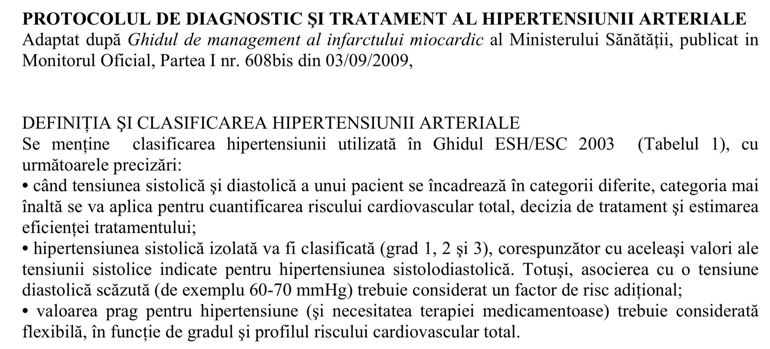
Protocoale 2018
https://www. ......../protocol-diagnostic-tratament-hipertensiune-arteriala.pdf

Slide 25
Ne putem permite medicatia la un numar asa mare de pacienti? Avem Protocoale?

Slide 26
Aplicarea Ghidurilor

Slide 27
Mortality in HFrEF remains high despite the introduction of new therapies that improve survival
Survival rates in chronic HF have improved with the introduction of new therapies¹
ACEI*
β-blocker*
MRA*
ARB*
16% (4.5% ARR; mean follow up of 41.4 months)
SOLVD-T^{1,2}
17%
(3.0% ARR; median follow-up of 33.7 months)
CHARM-Alternative⁵
Reduction in relative risk of
mortality vs placebo
30%
(11.0% ARR; mean follow up of 24 months) RALES⁴
34%
(5.5% ARR; mean follow up of 1.3 years) CIBIS-II³
However, significant mortality remains: ~50% of patients die within 5 years of diagnosis^{6–8}
*On top of standard therapy at the time of study (except in CHARM-Alternative where background ACEI therapy was excluded). Patient populations varied between trials and as such relative risk reductions cannot be directly compared. SOLVD (Studies of Left Ventricular Dysfunction), CIBIS-II (Cardiac Insufficiency Bisoprolol Study II) and RALES (Randomized Aldactone Evaluation Study) enrolled chronic HF patients with LVEF≤35%. CHARM-Alternative (Candesartan in Heart failure: Assessment of Reduction in Mortality and Morbidity) enrolled chronic HF patients with LVEF≤40%
1. McMurray et al. Eur Heart J 2012;33:1787–847; 2. SOLVD Investigators. N Engl J Med 1991;325:293–302; 3. CIBIS-II Investigators. Lancet 1999;353:9–13; 4. Pitt et al. N Engl J Med 1999;341:709-17;–50; 5. Granger et al. Lancet 2003;362:772–6; 6. Go et al. Circulation 2014;129:e28-e292; 7. Yancy et al. Circulation 2013;128:e240–327; 8. Levy et al. N Engl J Med 2002;347:1397–402
Notes:
Abbreviations
ACEI=angiotensin-converting enzyme inhibitor, ARB=angiotensin-receptor blocker; ARR=absolute risk reduction; CIBIS-II=Cardiac Insufficiency Bisoprolol Study II; HF=heart failure; HFrEF=heart failure with reduced ejection fraction; MRA=mineralocorticoid receptor antagonist; RAAS=renin-angiotensin aldosterone system; RALES=Randomized Aldactone Evaluation Study; SNS=sympathetic nervous system; SOLVD=Studies of Left Ventricular Dysfunction Treatment; CHARM=Candesartan in Heart failure: Assessment of Reduction in Mortality and morbidity
References
McMurray et al. Eur Heart J 2012;33:1787–847
SOLVD Investigators. N Engl J Med 1991;325:293–302
CIBIS-II Investigators. Lancet 1999;353:9–13
Pitt et al. N Engl J Med 1999;341:709-17;–50
Granger et al. Lancet 2003;362:772–6
Go et al. Circulation 2014;129:e28-e292
Yancy et al. Circulation 2013;128:e240–327
Levy et al. N Engl J Med 2002;347:1397–402

Slide 28
Primary outcome
Outcome, n % | LCZ696 (n=4187) | Enalapril (n=4212) | Hazard ratio* (95% CI) | p-value‡
Primary composite outcome
Death from CV causes or first hospitalization for worsening of HF | 914 (21.8) | 1117 (26.5) | 0.80 (0.73–0.87) | <0.001
Death from CV causes | 558 (13.3) | 693 (16.5) | 0.80 (0.71–0.89) | <0.001
First hospitalization for worsening of HF | 537 (12.8) | 658 (15.6) | 0.79 (0.71–0.89) | <0.001
*Calculated with the use of stratified cox proportional-hazard models
‡Two-sided p-values calculated by means of a stratified log-rank test without adjustment for multiple comparisons
The difference in favor of LCZ696 was seen early in the trial and at each interim analysis
Over the duration of the trial, the numbers of patients who would need to have been treated (NNT) to prevent:
one primary event was 21 patients, and
one death from CV causes was 32 patients
McMurray, et al. N Engl J Med 2014; ePub ahead of print: DOI: 10.1056/NEJMoa1409077.
Notes:
Abbreviations
CI=confidence intervals; CV=cardiovascular; HF=heart failure; NNT=number needed to treat
Reference
McMurray, et al. N Engl J Med 2014; ePub ahead of print: DOI: 10.1056/NEJMoa1409077.

Slide 29
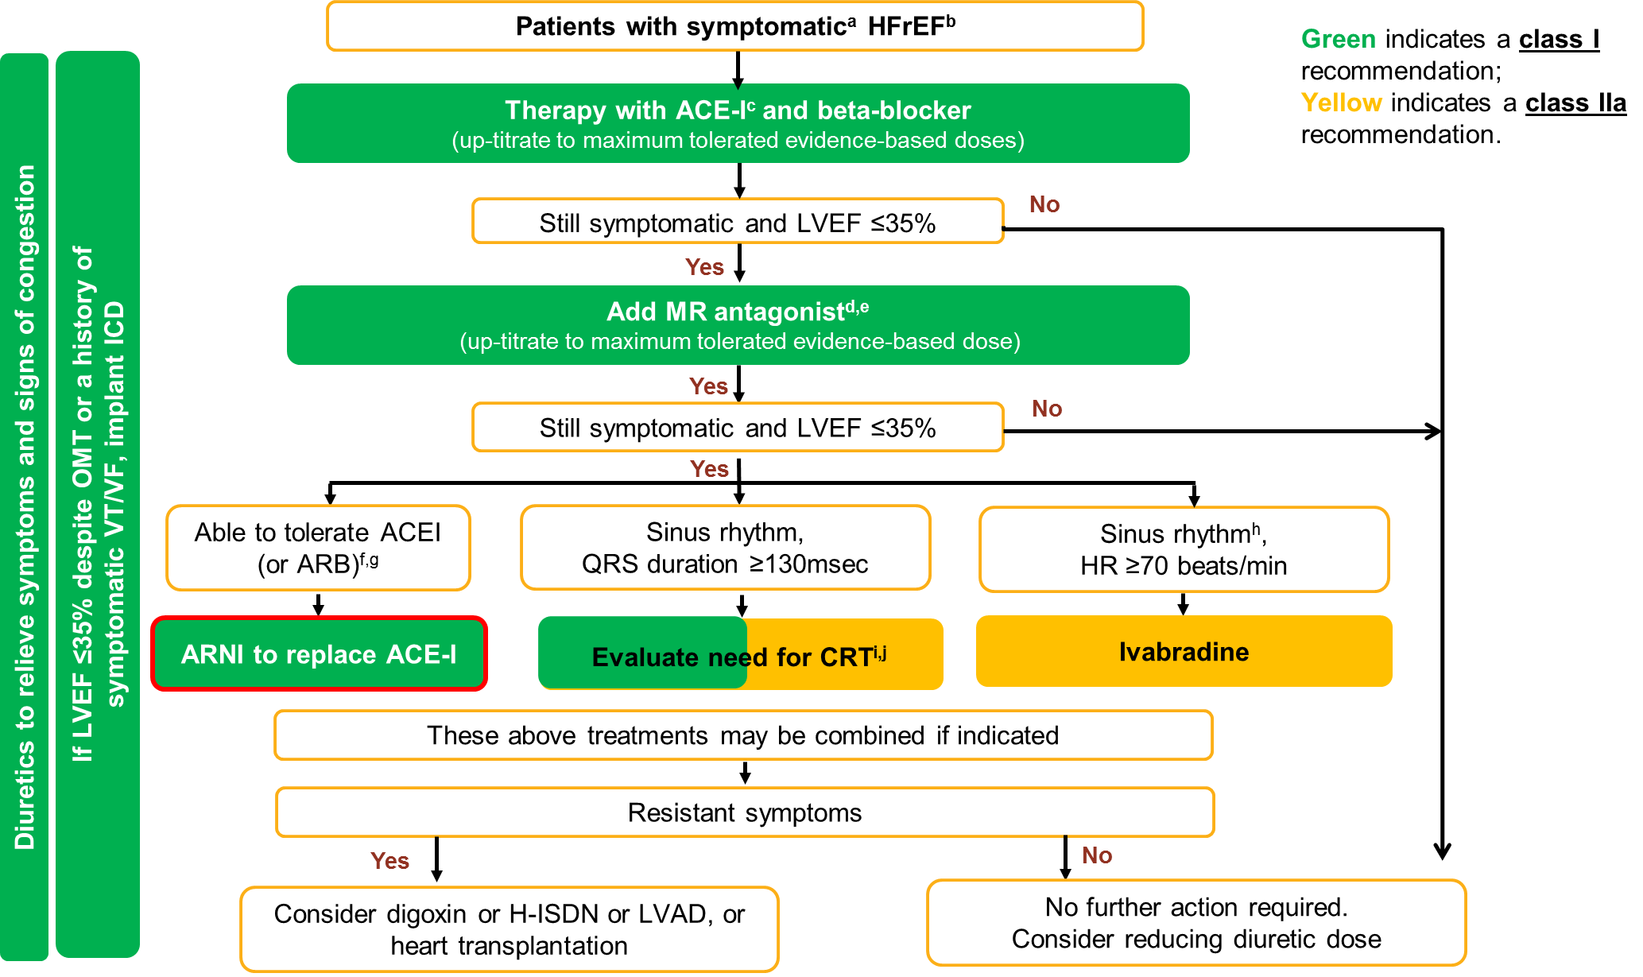
ªSymptomatic=NYHA Class II-IV; ^{b}HFrEF=LVEF<40%; ^{c}If ACEI not tolerated/contra-indicated, use ARB; ^{d}If MR antagonist not tolerated/contra-indicated, use ARB; ^{e}With a hospital admission for HF within the last 6 months or with elevated natriuretic peptides (BNP >250 pg/ml or NTproBNP >500 pg/ml in men and 750 pg/ml in women); ^{f}With an elevated plasma NP level (BNP ≥150 pg/mL or plasma NT-proBNP ≥ 600 pg/mL, or if HF hospitalization within recent 12 months plasma BNP ≥ 100 pg/mL or plasma NT-proBNP ≥ 400 pg/mL); ^{g}In doses equivalent to enalapril 10 mg b.i.d.; ^{h}With a hospital admission for HF within the previous year; ^{i}CRT is recommended if QRS ≥ 130 msec and LBBB (in sinus rhythm); ^{j}CRT should/may be considered if QRS ≥ 130 msec with non-LBBB (in a sinus rhythm) or for patients in AF provided a strategy to ensure bi-ventricular capture in place (individualized decision)

Slide 30
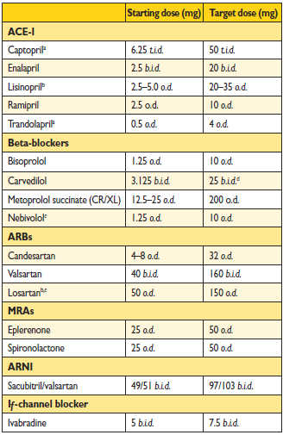
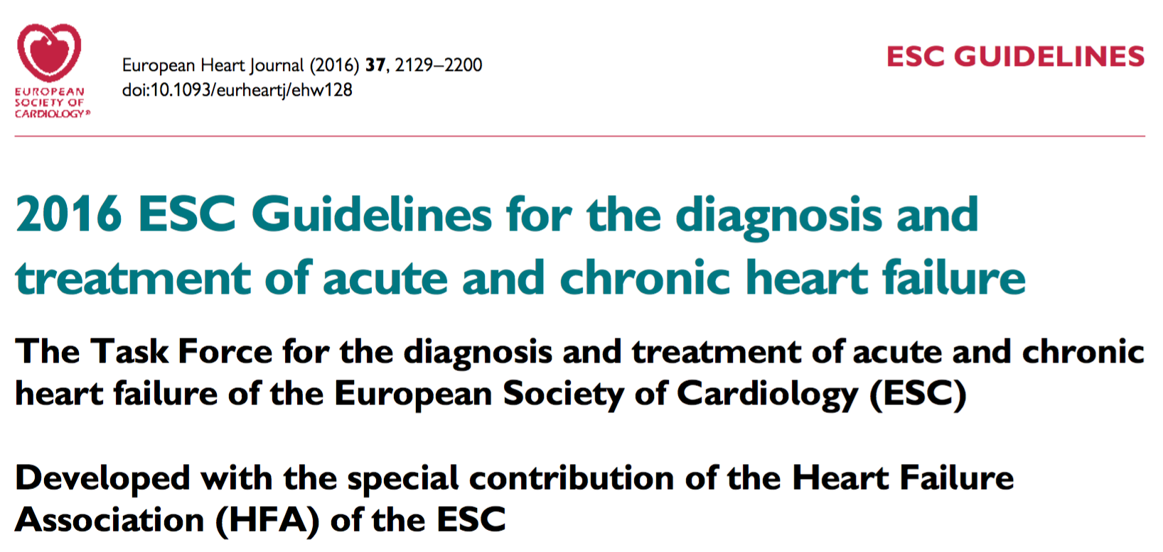
Transition to sacubitril/valsartan may occur upon physicians’ judgement following up titration to maximum-tolerated evidence-based doses of an ACEi/ARB, BB, and MRA
ESC-HF treatment algorithm recommends patients to be transitioned to sacubitril/valsartan if they are still symptomatic on enalapril dose of 10 mg b.i.d.
ARNI, angiotensin receptor neprilysin inhibitor; ACEI angiotensin converting enzyme inhibitor; ARB, angiotensin receptor blocker ; BB, beta blocker; b.i.d., twice daily; HF, heart failure; MRA, mineralocorticoid receptor antagonist
Ponikowski et al. Eur Heart J. 21 May 2016. doi:10.1093/eurheartj/ehw128

Slide 31
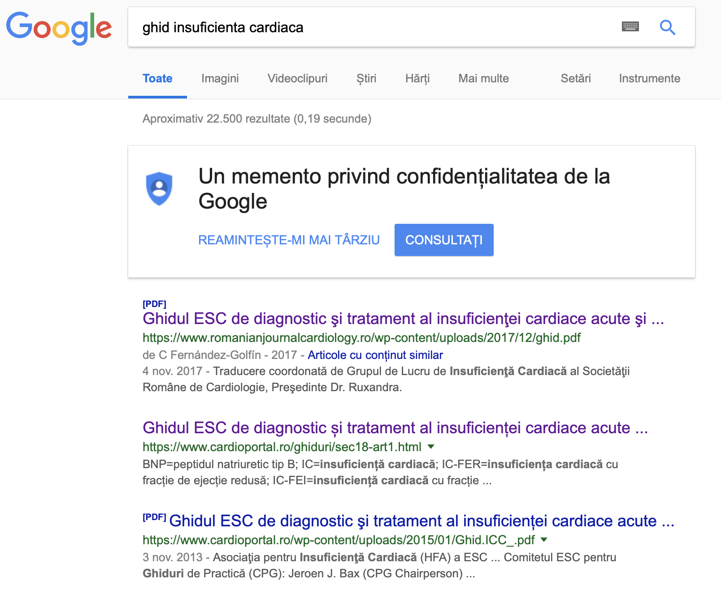
Unde ne aflam noi? 24.10.2018

Slide 32
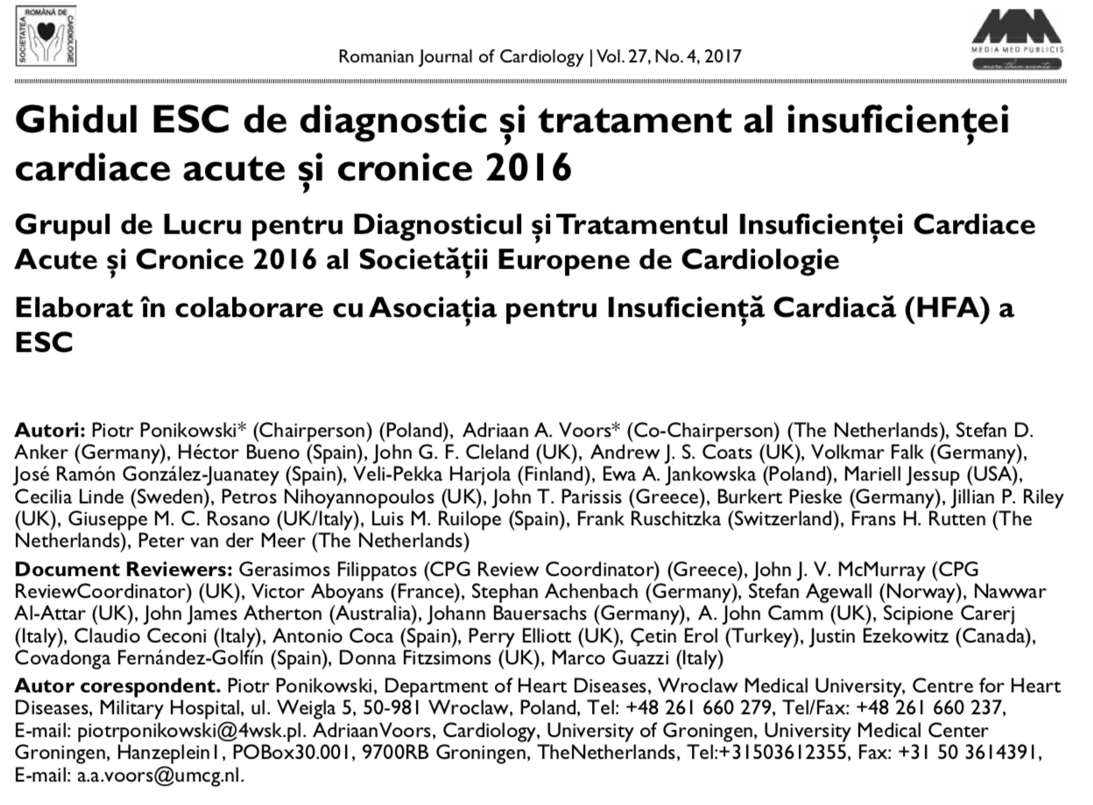

Slide 33
Unde ne aflam noi? 24.10.2018

Slide 34
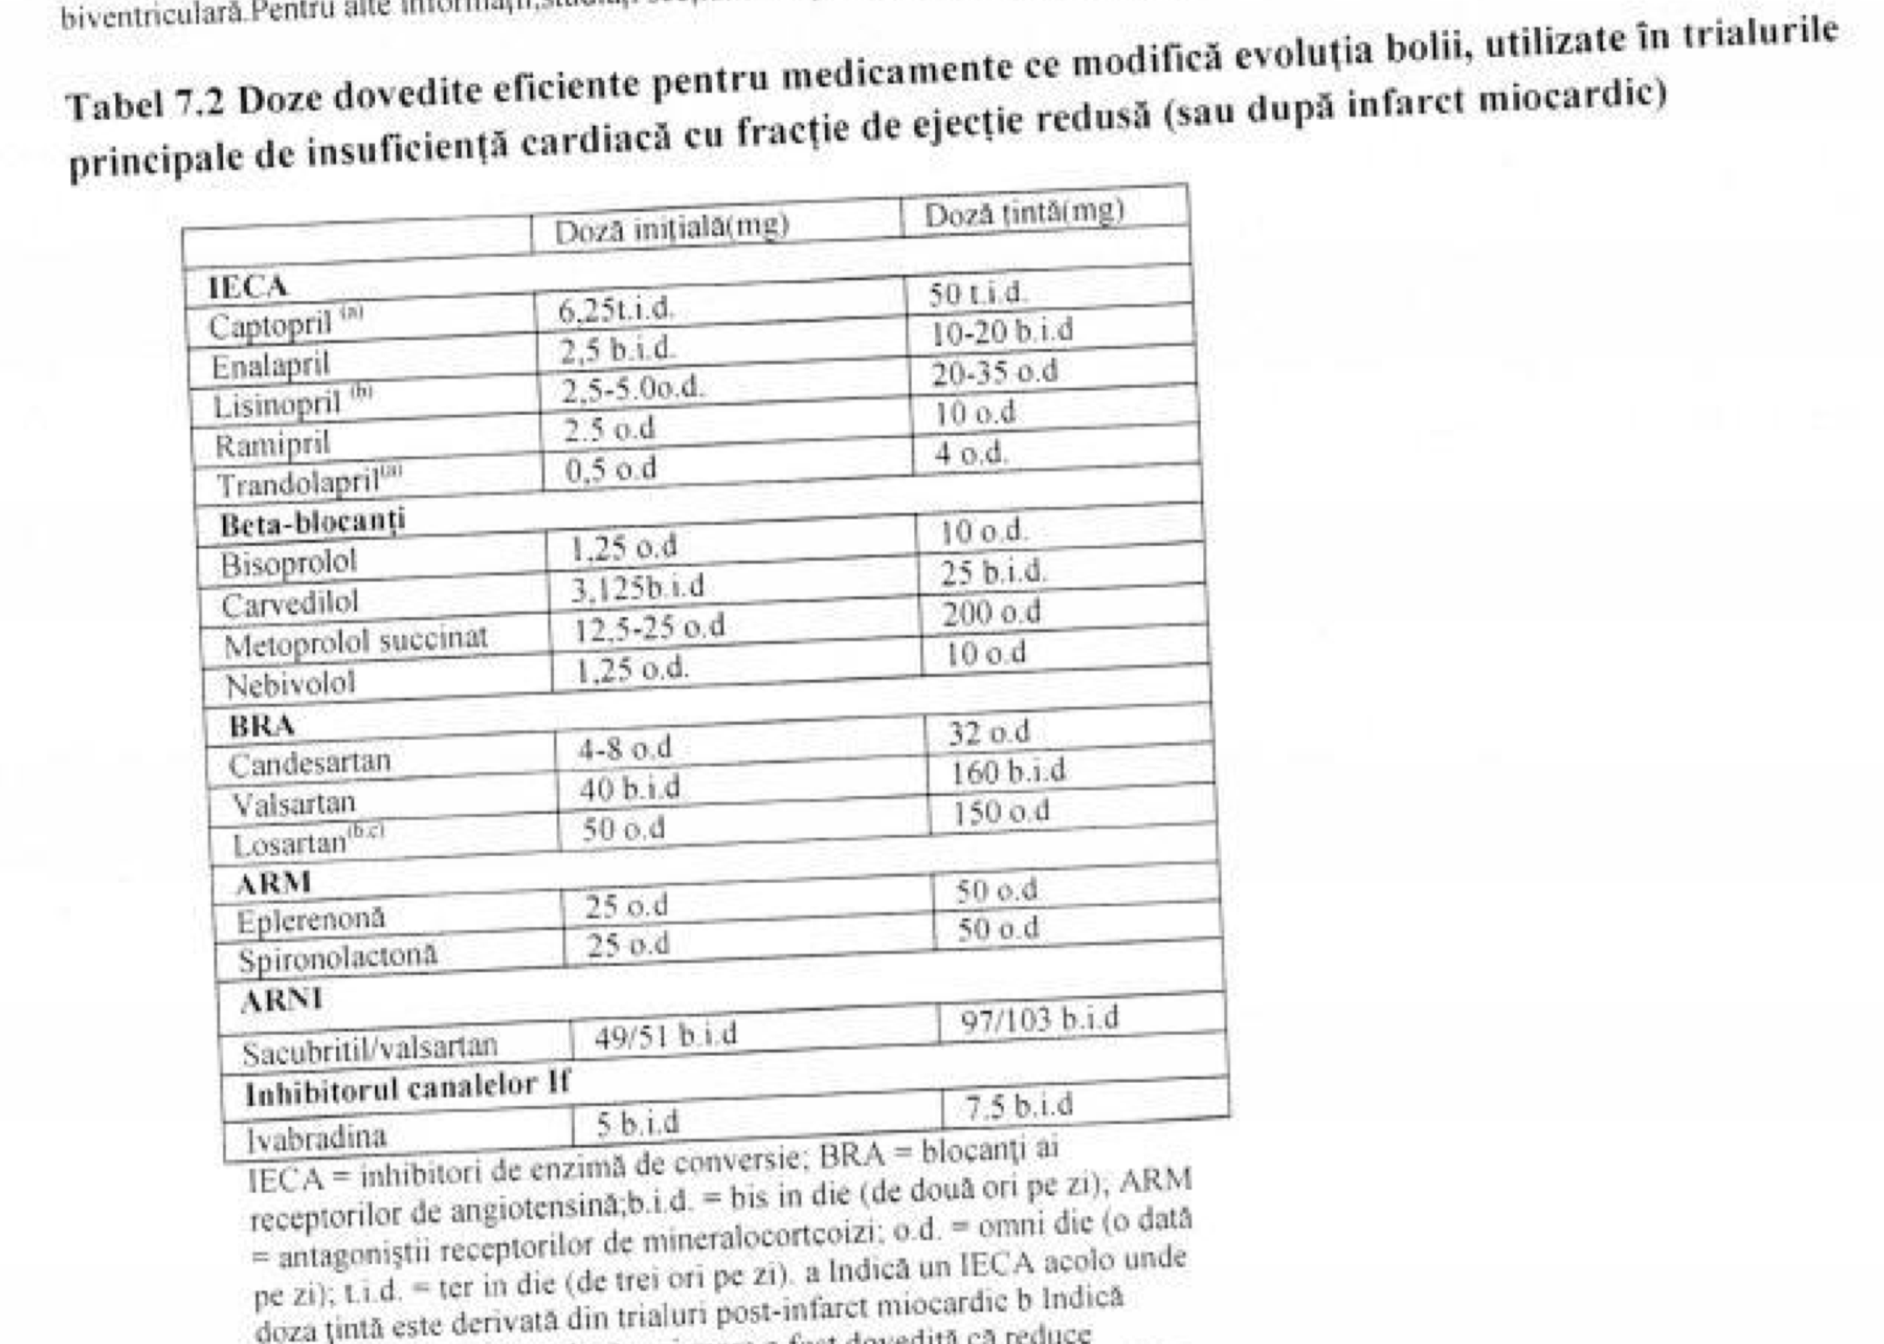

Slide 35
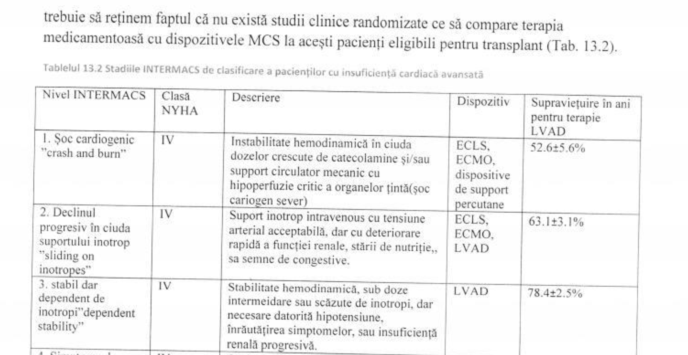

Slide 36
Neaplicarea Ghidurilor? Neaplicarea Protocoalelor? Avem fonduri pentru noile indicatii? Daca CNAS nu compenseaza cum ramane cu protocoalele noastre?

Slide 37
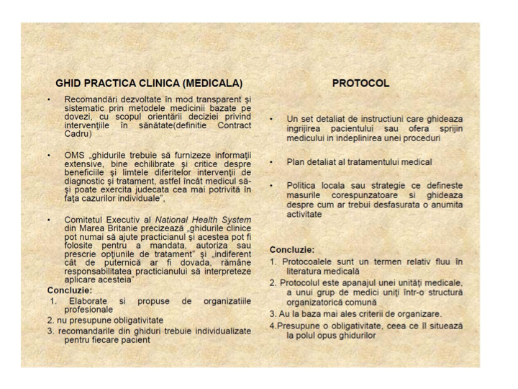

Slide 39
Concluzii
Exista Ghiduri de terapie .........
Dar ne putem permite toate indicatiile?
Exista ...... Protocoale ......
Dar am putea sa le actualizam individual sau centralizat, si sa ne permitem terapia?
Cel mai important:
Individualizarea pacientului si clasificarea dupa cele mai noi scheme cu o terapie cat mai apropiata de ziua de astazi

Slide 40
Motto:

